Slide 1

COS214-Project Restaurant Simulation System
No Girls Allowed(Except Monica)
James Cooks - u21654680, Lloyd Creighton - u04954336, Quintin d'Hotman de Villiers - u21513768, Yi-Rou Monica Hung - u22561154, Qwinton Knocklein - u21669849, Chanseop Carter Shin - u21470864, Ze-Lin Daniel Zhang - u22614495

Slide 2
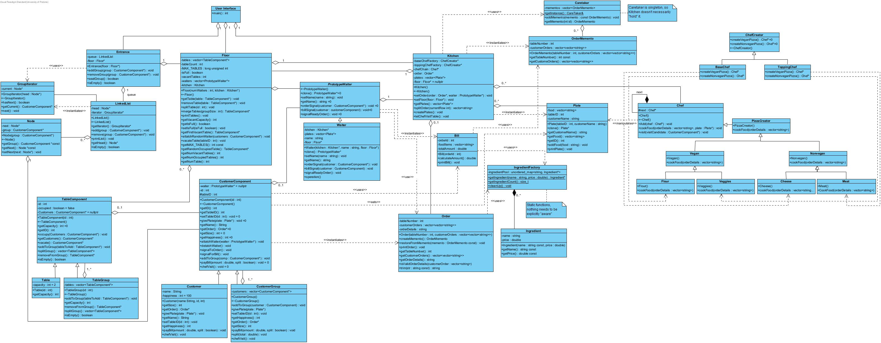
Let us start with an overview of the system
However, this is a bit much to take in so let's simplify this a bit

Slide 3
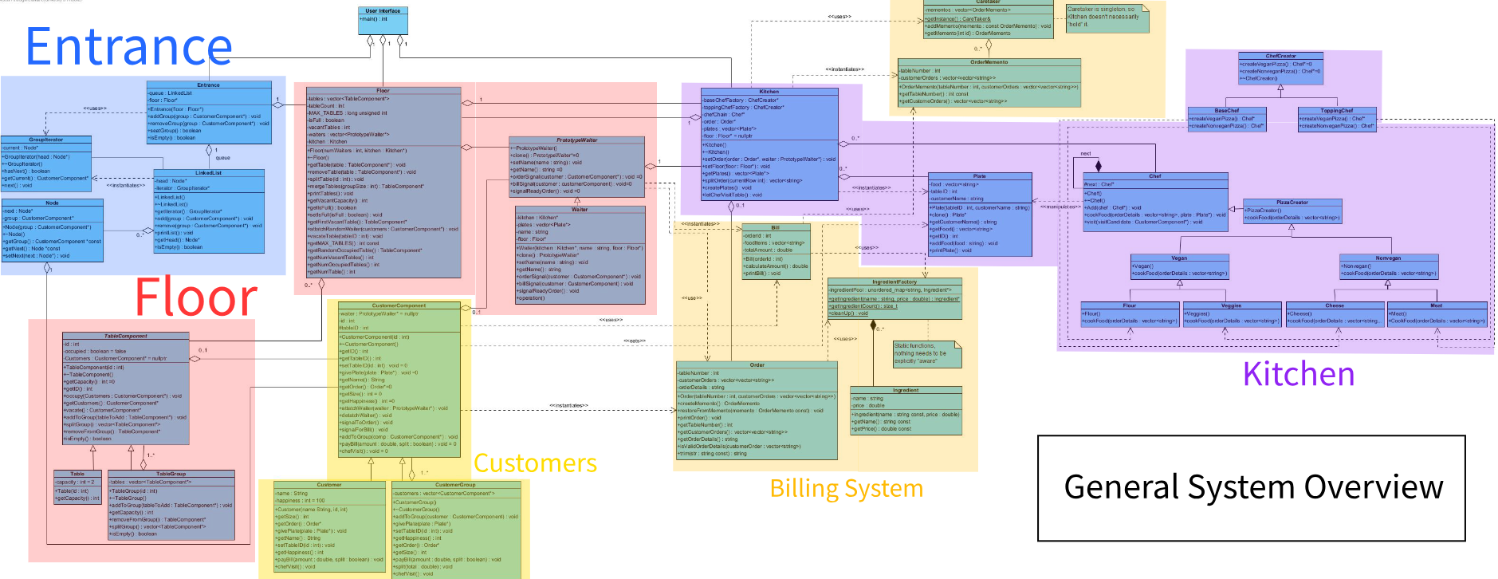
A high-level overview of our system

Slide 4
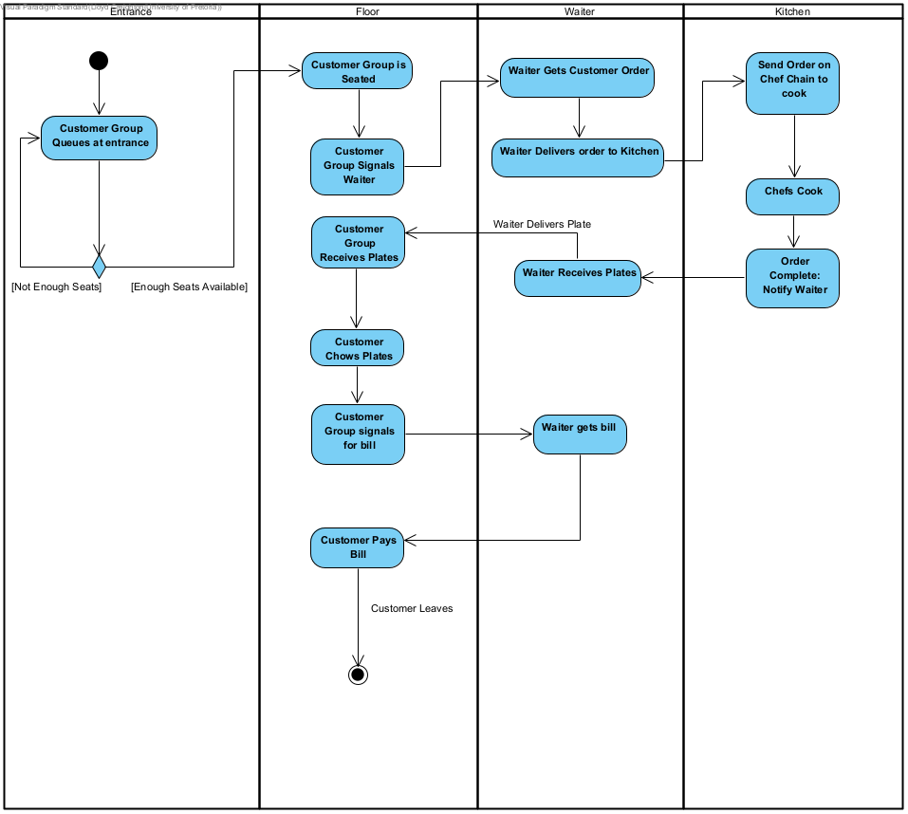
The general flow of our system

Slide 5
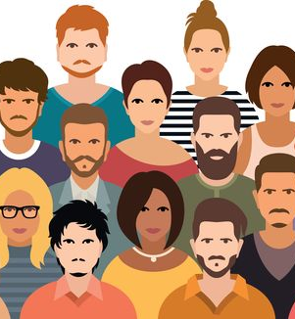
Our subsystems - Customers
Customers act as the lifeblood of the system.
They kick off all the moving parts when they enter the system
They support operations like ordering, eating and paying
This Photo by Unknown Author is licensed under CC BY

Slide 6
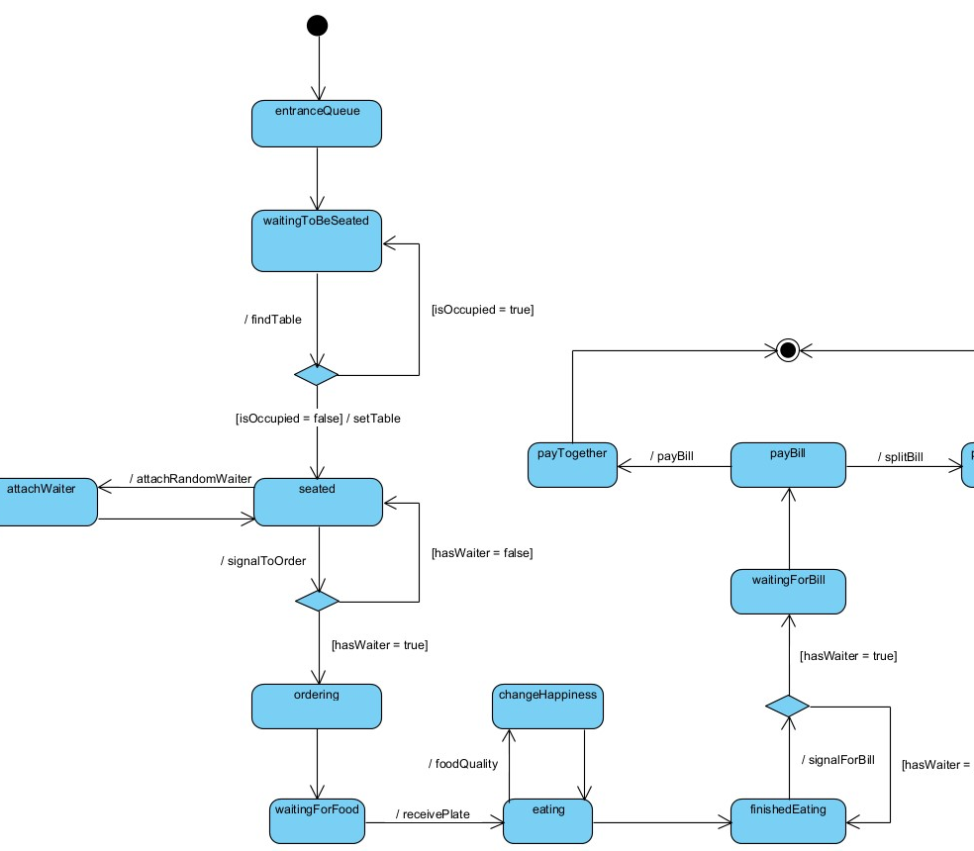
Our subsystems - Customers

Slide 7
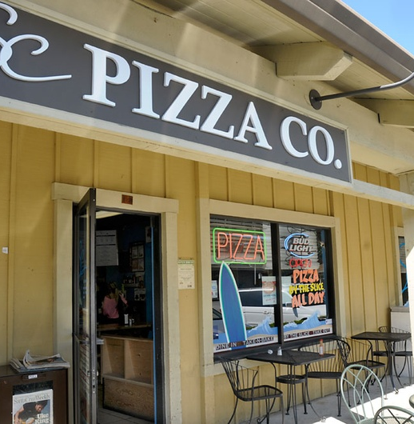
Our subsystems - Entrance
The entrance is well the entry point and is responsible for letting customers form a queue to get into the system. The entrance is also responsible for seating customers based on the state of the floor.
This Photo by Unknown Author is licensed under CC BY

Slide 8
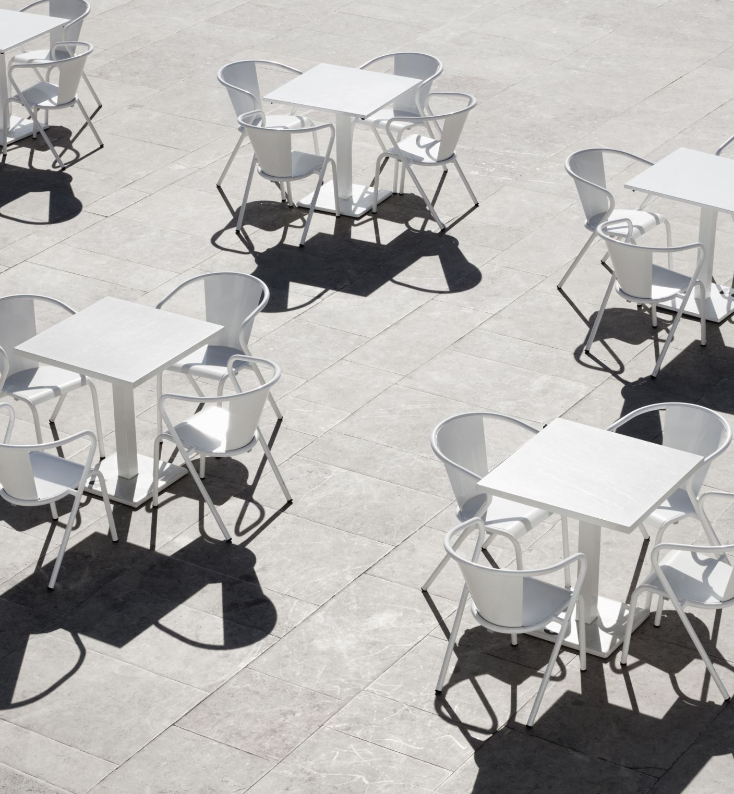
Our subsystems - Floor
Floor manages 2 main things: Tables and Waiters
Tables: It is responsible for merging tables to accommodate big groups of customers
Waiters: The floor assigns waiters to a customer group.

Slide 9
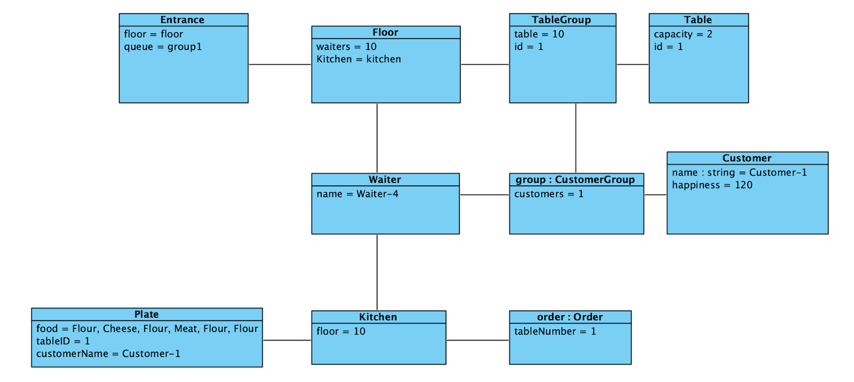
Our subsystems - Floor

Slide 10
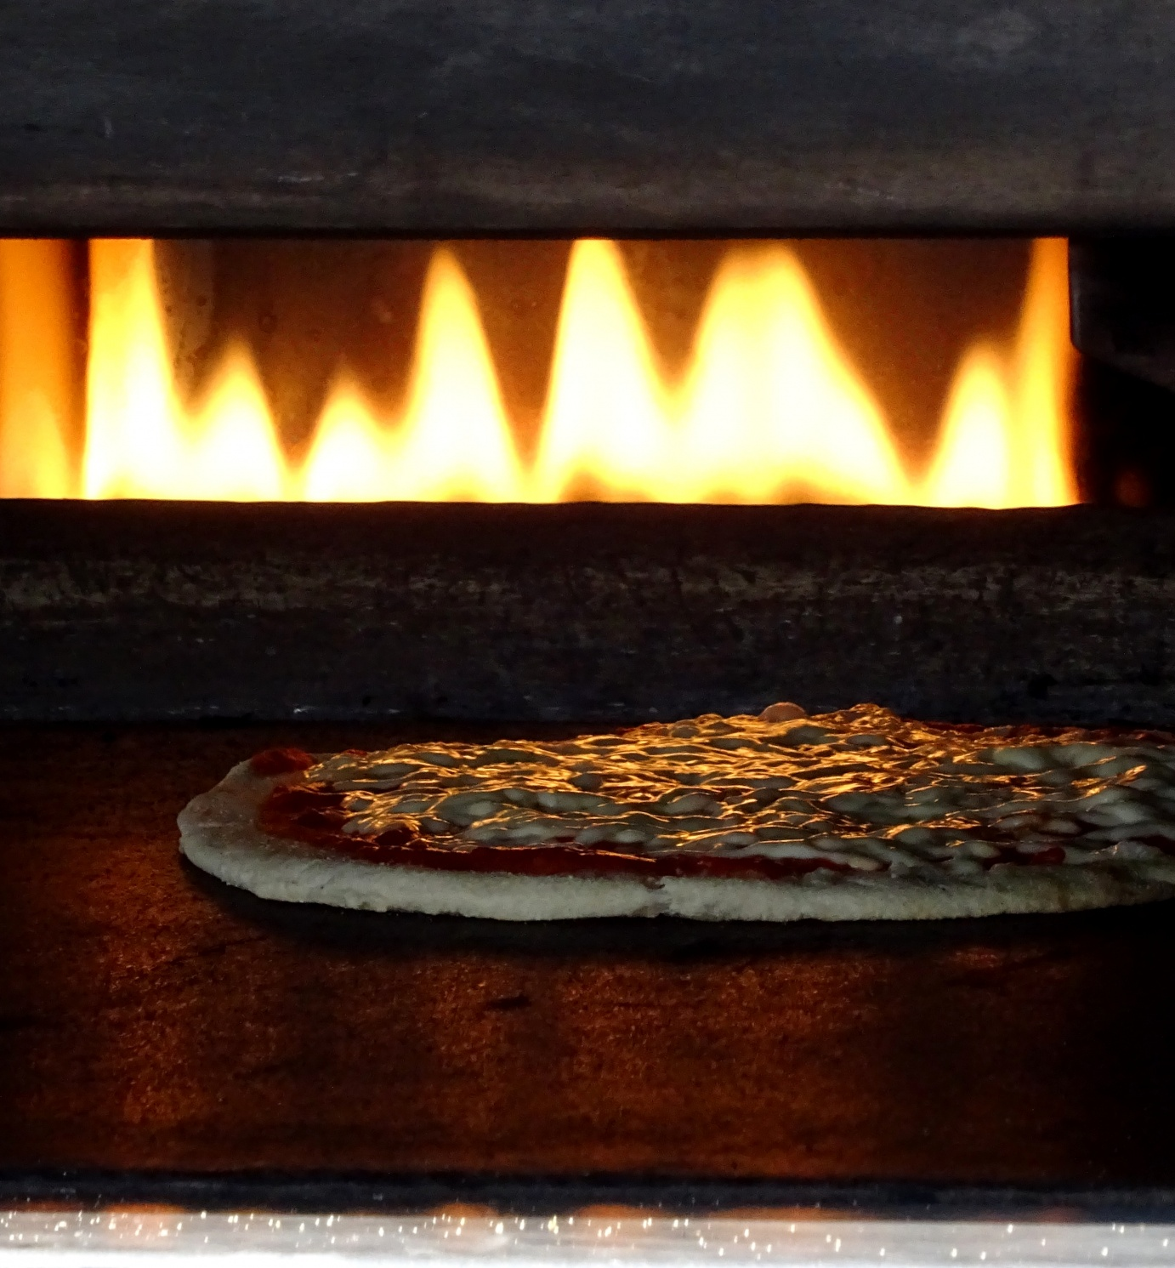
Our subsystems – Kitchen
The kitchen is where orders are received from the waiter and then processed and returned to the waiter to server our customers.

Slide 11
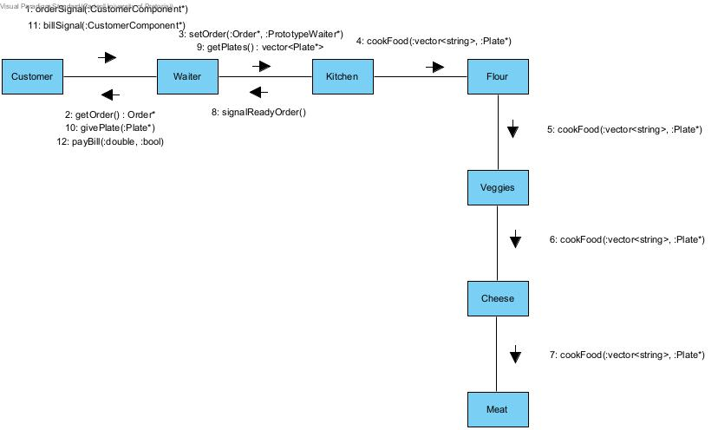
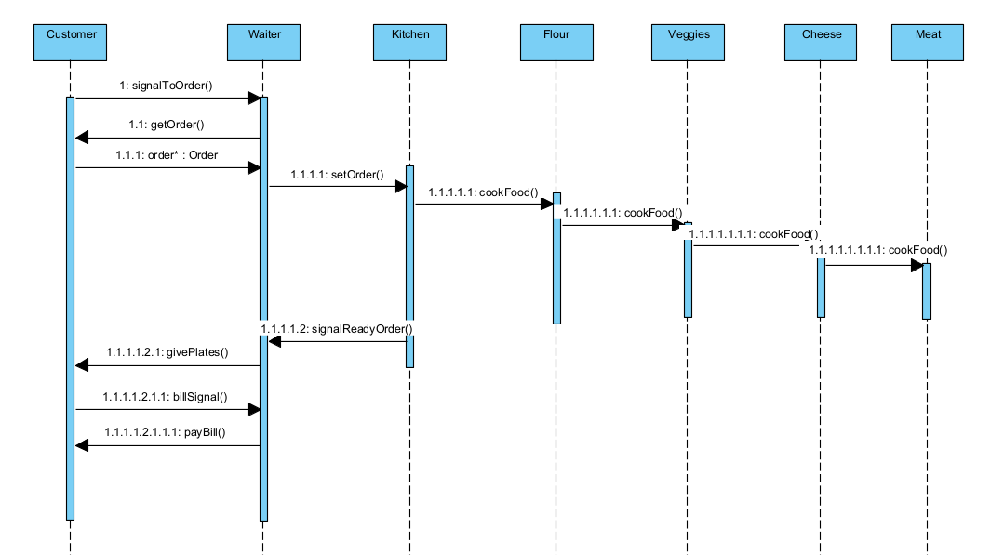
Our subsystems - Kitchen

Slide 12
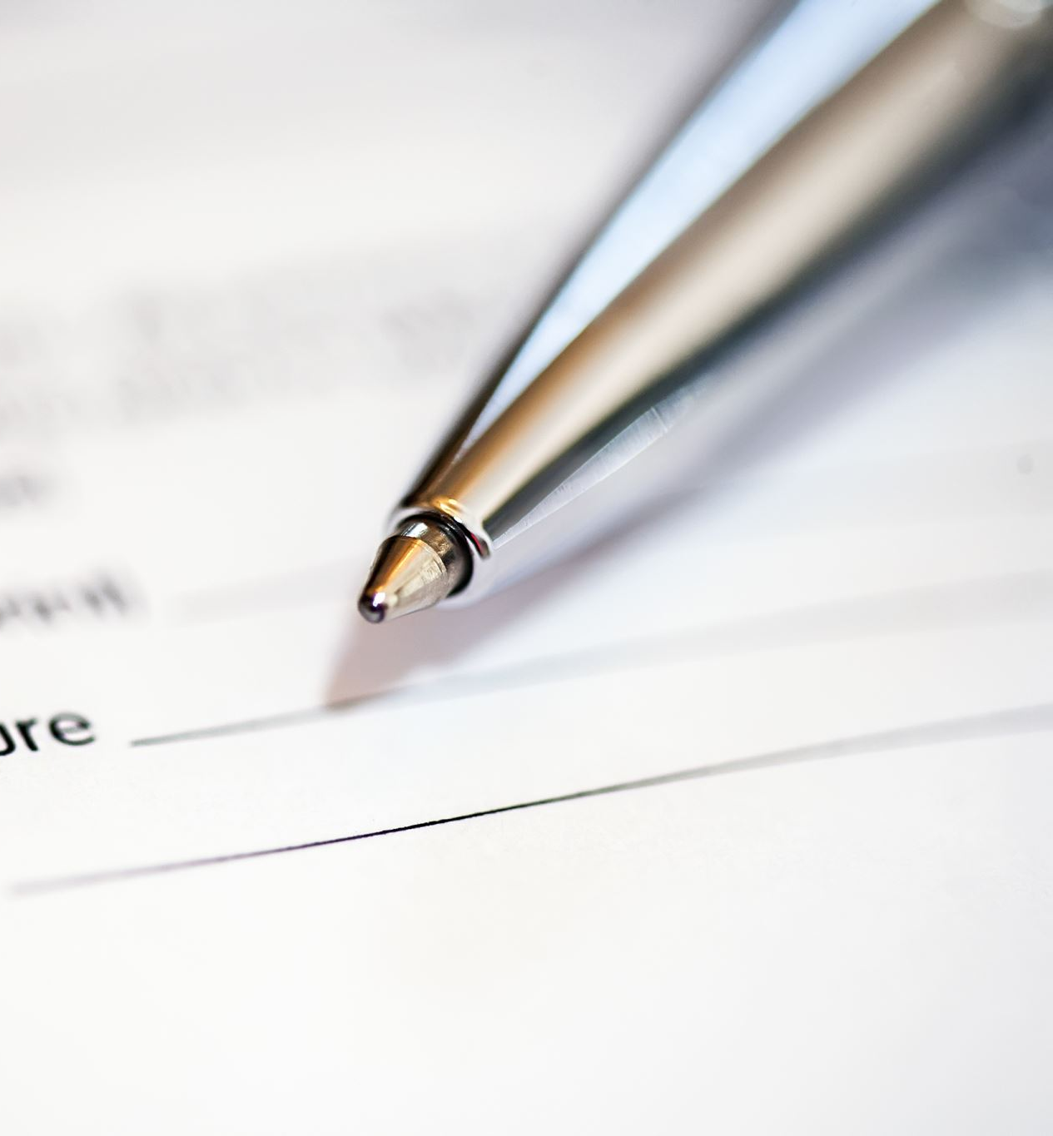
Our subsystems – Billing system
Our billing system consists of the orders and the bill and order memento systems.
Bills are generated using the memento coupled with a flyweight.
Bills can be split amongst a table to paid in full by one customer.

Slide 13

Assumptions made in the project
Although we do have the code to iterate over the whole entrance and select specific customer groups based on floor availability. Upon testing however, we found that this made it impossible to serve large groups without implementing unnecessary overhead of how long customers have been waiting.
When working with groups we only wanted to allow groups to order once and then leave the system after paying as otherwise simulations would go on for too long and become redundant and hard to read.
CUSTOMERS LOVE EATING PLATES. This means we don’t deal with passing dirty plates back to the kitchen. We thought it was much funnier making customers deallocate their plates.

Slide 14
Our design patterns

Slide 15
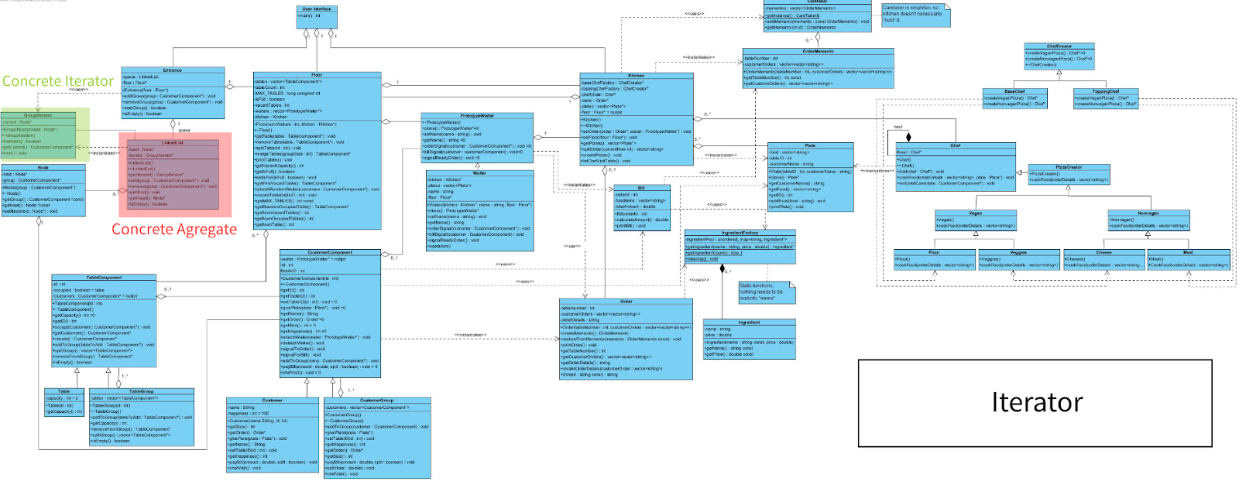
Iterator

Slide 16
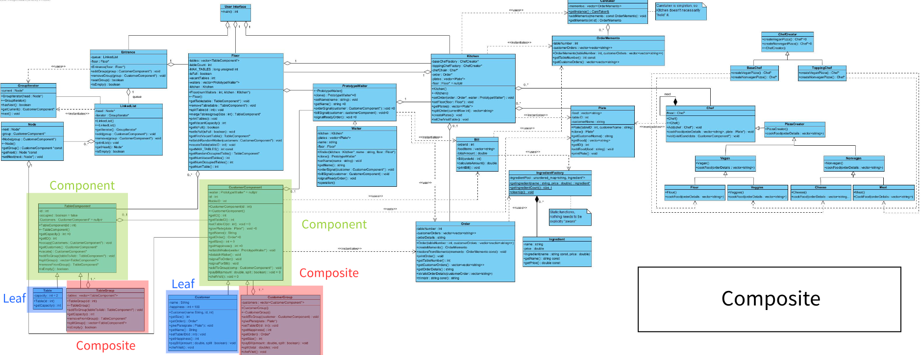
Composite

Slide 17
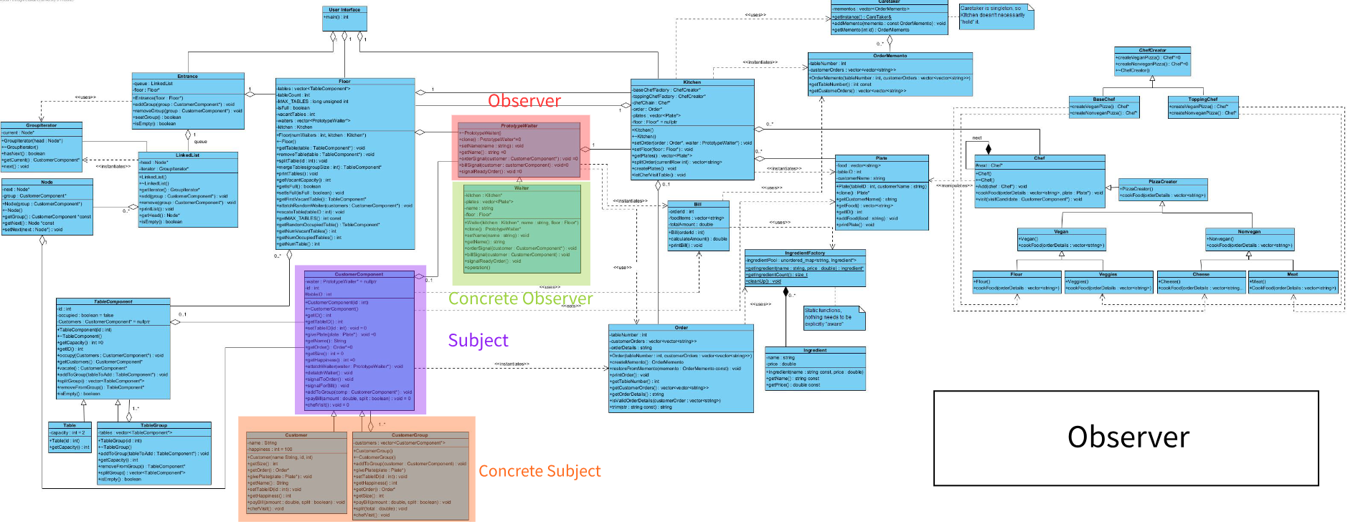
Observer

Slide 18
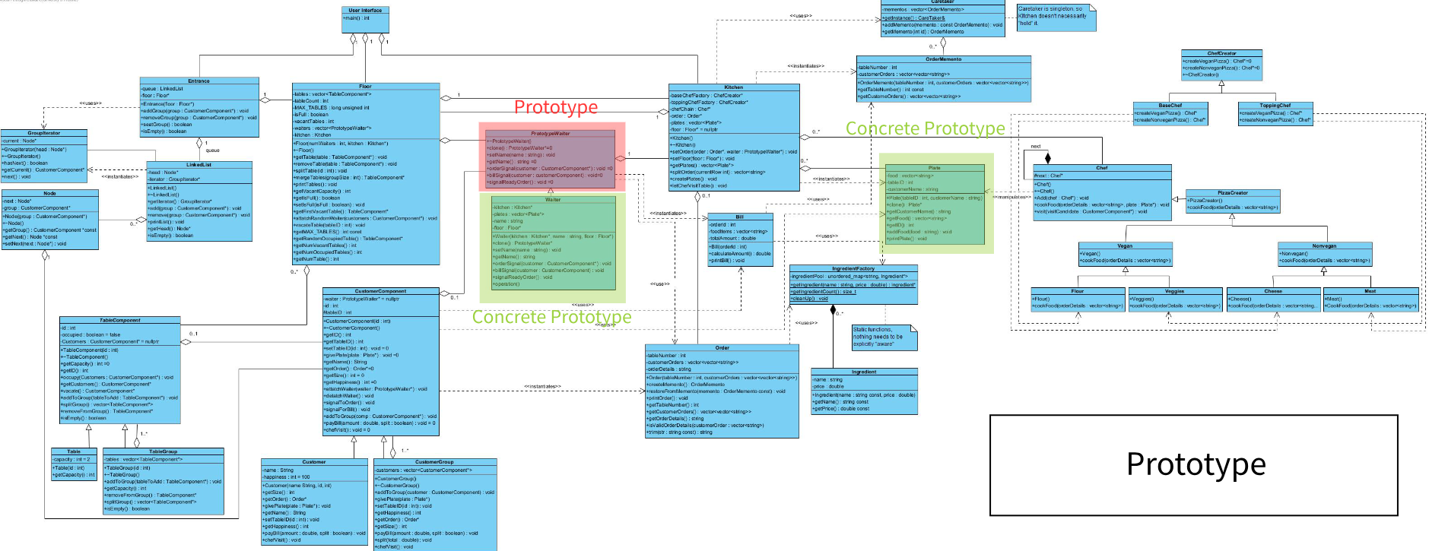
Prototype

Slide 19
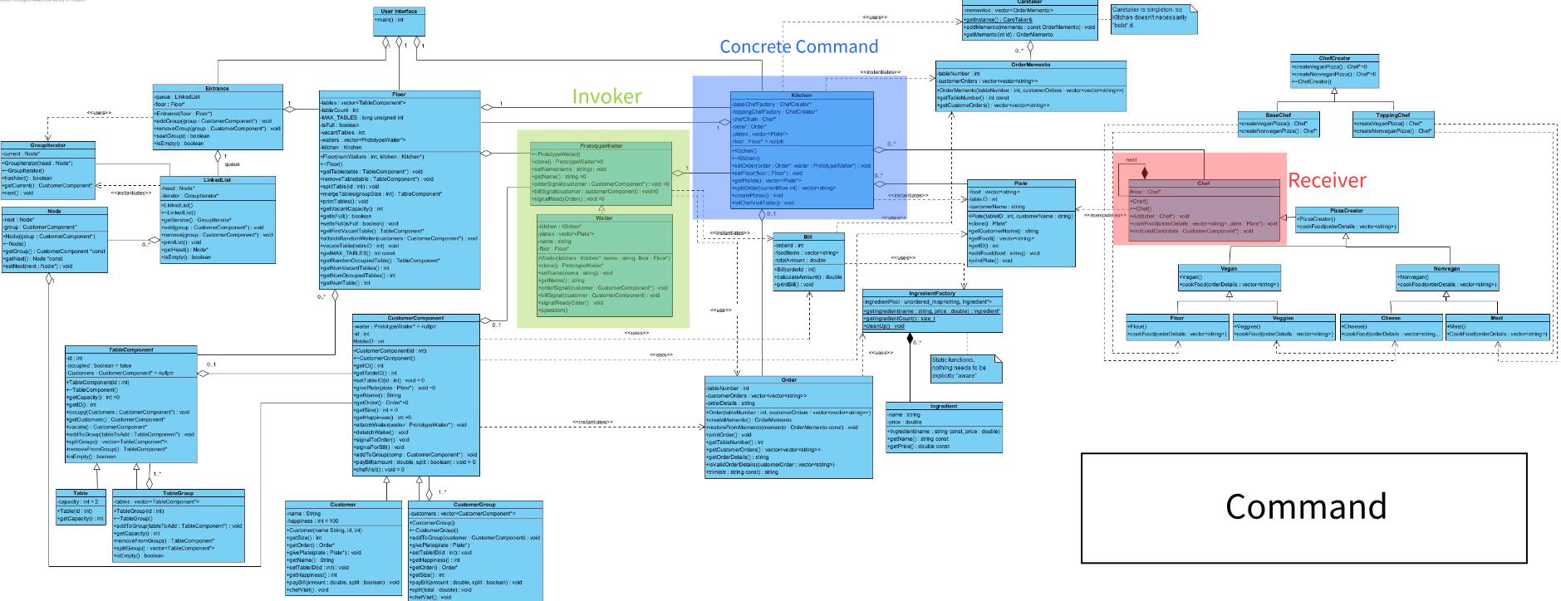
Command

Slide 20
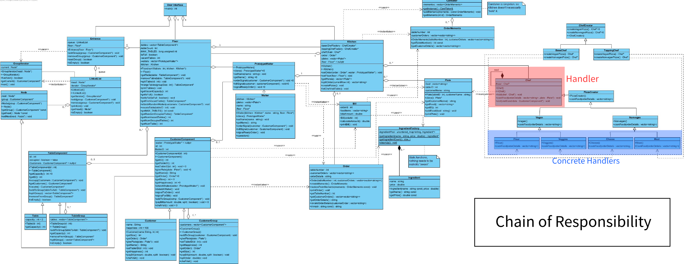
Chain of Responsibility

Slide 21
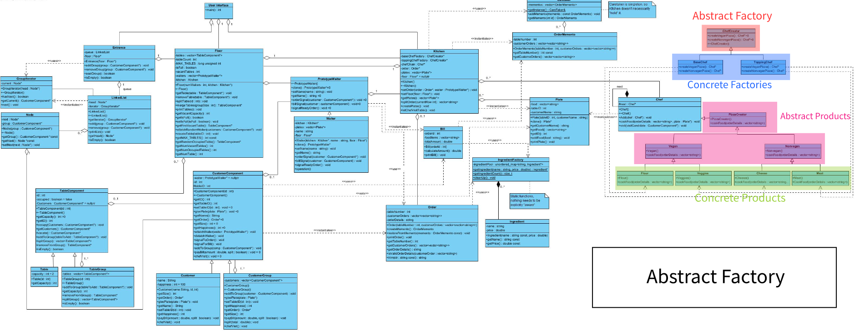
Abstract Factory

Slide 22
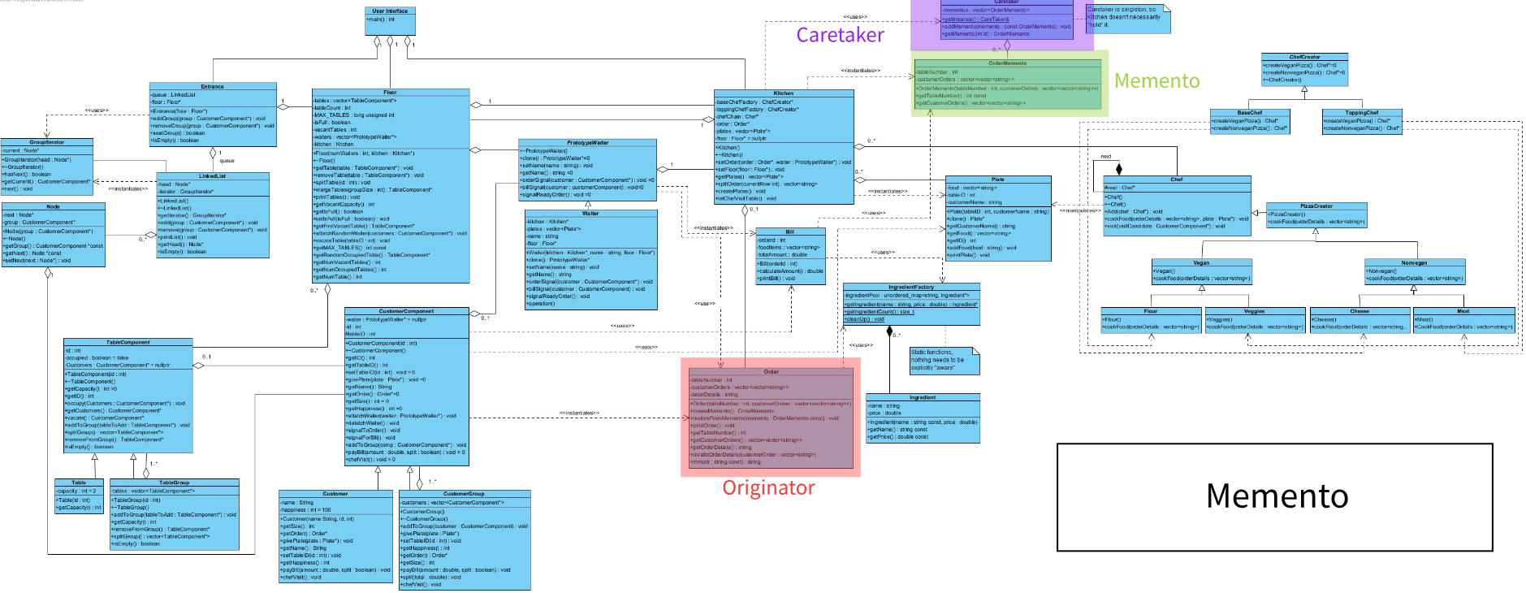
Memento

Slide 23
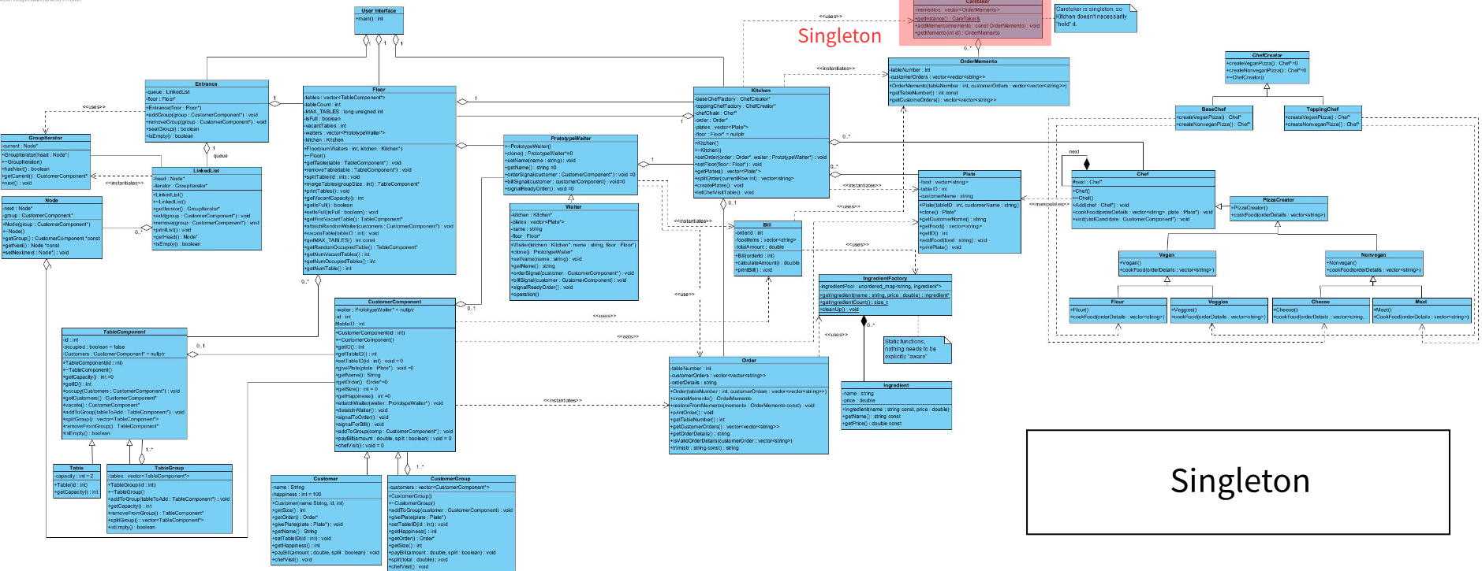
Singleton

Slide 24
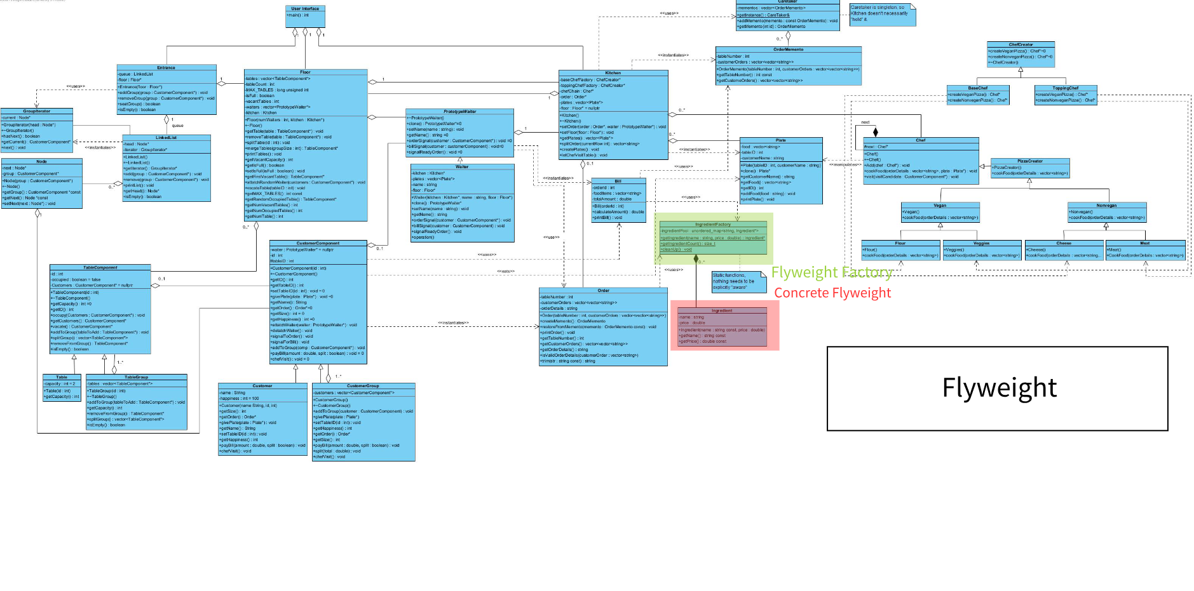
Flyweight

Slide 25
Methods and Technology

Slide 26
Our method of development
Code
Test
Design

Slide 27
Software used to aid in the project

Slide 28
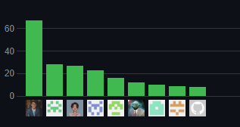
GitHub

Slide 29

Whatsapp

Slide 30

GitHub Codespaces/Liveshare
This Photo by Unknown Author is licensed under CC BY-SA-NC

Slide 31

Notion
This Photo by Unknown Author is licensed under CC BY-SA

Slide 32

Discord
This Photo by Unknown Author is licensed under CC BY-NC

Slide 33
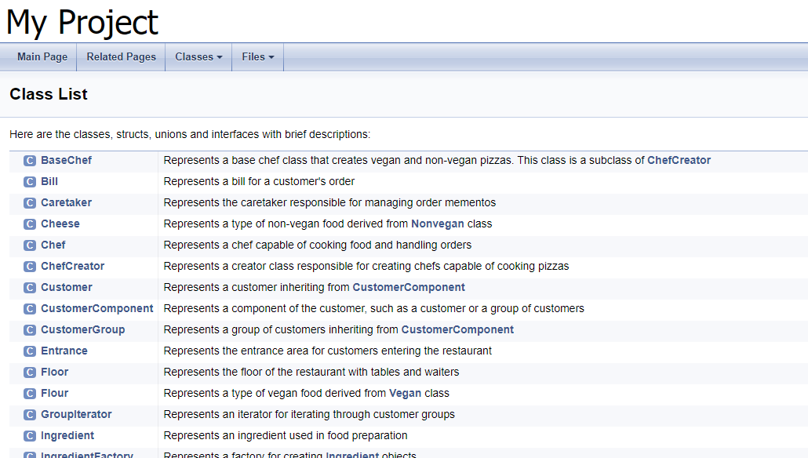
Doxygen

Slide 34
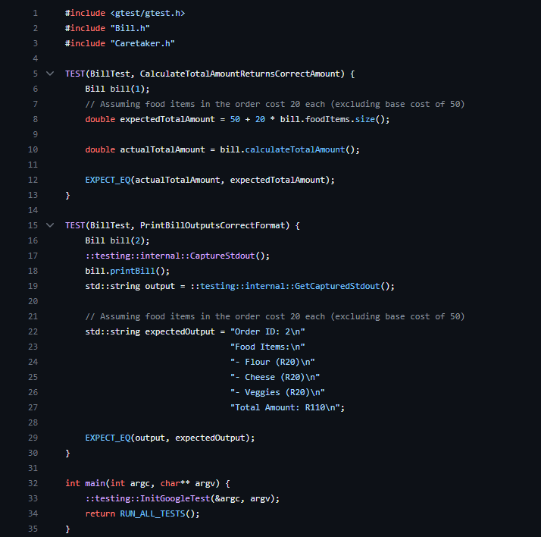
Google Tests

Slide 35
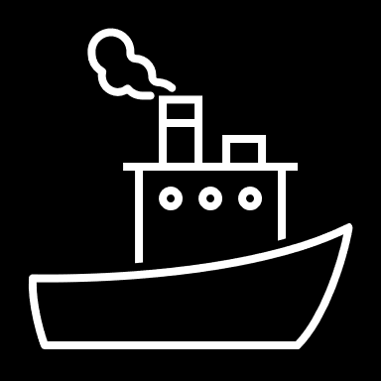
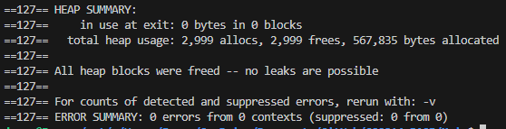
Valgrind

Slide 36
Thanks to Luca, Ronin and Jason for the guidance provided.

Slide 37

Any questions?

